Slide 1

PRESENTATION ON TUTORING LIBRARY
BY
Ishita Maurya (ECC1814007)
Sahil Dwivedi (ECC1814064)

Slide 2
CONTENT
1. INTRODUCTION
2. OBJECTIVES
3. PROPOSED SYSTEM
4. MODULE
5. ER DIAGRAM
6. DFD
7. DATABASE
8. RESOURCE
9. PROS AND CONS
10. FUTURE SCOPE
11. CONCLUSION
12. REFERENCES

Slide 3
INTRODUCTION
Tutoring library is a integrated and collaborative learning platform assist the students to learn in an interactive manner.
The main aim of this Project is to complement the efforts of teachers to integrate technology and link the students to the technology in educationally productive ways.
This Tutoring library project also provides students a stimulating, positive and enjoyable environment to study.

Slide 4
OBJECTIVES
Providing a integrated healthy environment and reliable platform.
Make sure easy understanding of ‘BCA’ course syllabus of our college.
To enhance the subjective and objective approach in all kind of educational activity in professional manner.
To do encourage students to getting all possible opportunity present in field.

Slide 5
PROPOSED SYSTEM
In the existing system student suffer from lack of exact overview of what kind of subject we going to learn and how many aspect it covers.
The proposed system maintains all student information in the database. Information can be entered offline.
Time can be saved and don’t need any special maintenance. Information once stored can be updated, edited and deleted.

Slide 6
MODULE
ADMIN
MANAGE OWN, USER ACCOUNT OPENING AND UPDATING
USER
IT CONSIST STUDENT PROFILE
VIEW STUDY MATERIALS AND PREVIOUS YEAR QUESTION PAPERS
OWNER
HOME
MANAGE ADMIN AND USER LOGIN

Slide 7
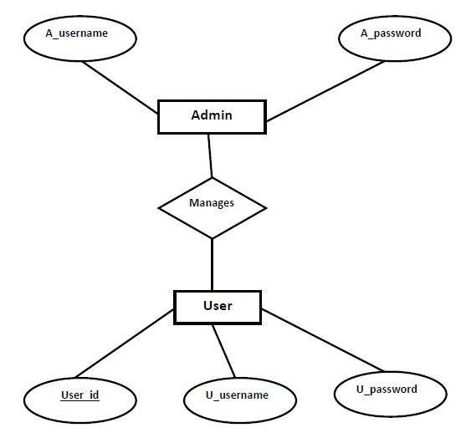
ER DIAGRAM

Slide 8
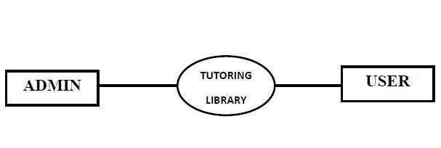
0-LEVEL DFD

Slide 9
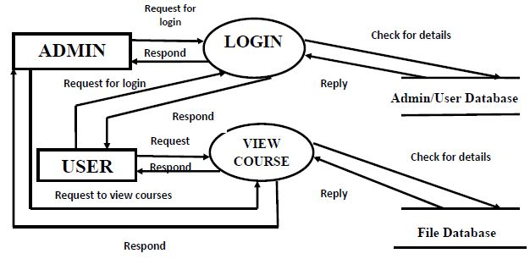
1-LEVEL DFD

Slide 10
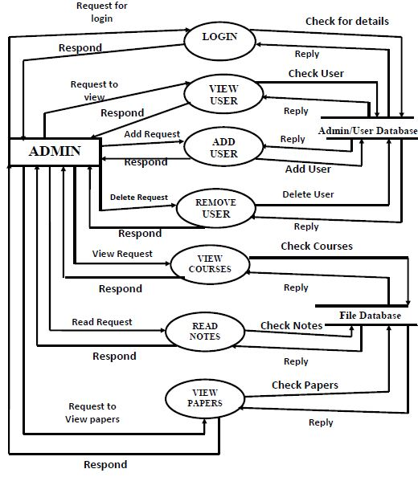
1-LEVEL DFD FOR ADMIN

Slide 11
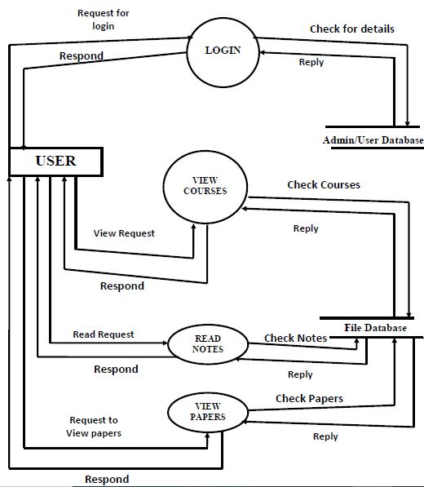
1-LEVEL DFD FOR USER

Slide 12
DATABASE
Field | Data type | Constraint
A_username | Varchar2(25) | Not Null
A_Password | Varchar2(20) | Not Null
ADMIN TABLE
Field | Data type | constraint
User_id | Integer(10) | Primary key
U_username | Varchar(25) | Not Null
U_password | Varchar(25) | Not Null
USER TABLE

Slide 13
RESOURCE
Software Requirements
Hardware Requirements
Name of Components | Specification
Language | Java
Database | Oracle
Software Development kit | Jdk, Notepad++
Name of Components | Specification
Processor | Intel Pentium IV(or equivalent)
RAM | 2GB
Hard Disk | Minimum 4GB

Slide 14
PROS AND CONS
PROS
CONS
EASY TO USE
FASTER AND CHEAPER
OFFLINE ACCESSIBILITY
STUDENTS COULD BE MORE COMFORTABLE
LIMITED CONTENT
REQUIRES SMART ADMIN
PDF FILE TYPE
STUDY MATERIAL

Slide 15
FUTURE SCOPE
In future it will converted into website and the dimension of it consist of various type of technology
The broad-band of Tutoring library varies from distance education, learning online, computerized electronic learning, and many others which makes it more appealing to the public.

Slide 16
CONCLUSION
From the above discussion we conclude that Implementation of tutoring library Java Project has been satisfactorily performed the task of educating students offline.

Slide 17
REFERENCES
1. Www.github.com
2. Www.oracle.com
3. Www.stackoverflow.com
4. Www.coursera.org

